Slide 1
REST API
WireMock
learn more

Slide 2
What is Mocking?

Slide 3
What is Mocking?
Mocking in API testing refers to the simulation of API behaviours without invoking the real API endpoints.
This technique allows developers and testers to mimic the responses from external services and systems without relying on their actual implementations.

Slide 4
What is the purpose for mocking?

Slide 5
What is the purpose for mocking?
The main purpose of mocking is to enable testing of an application's business logic independently of external dependencies.
Mocking is also used when you're performing in-sprint automation. If the developer hasn't created the required service, we can create a mock and start writing our script.

Slide 6
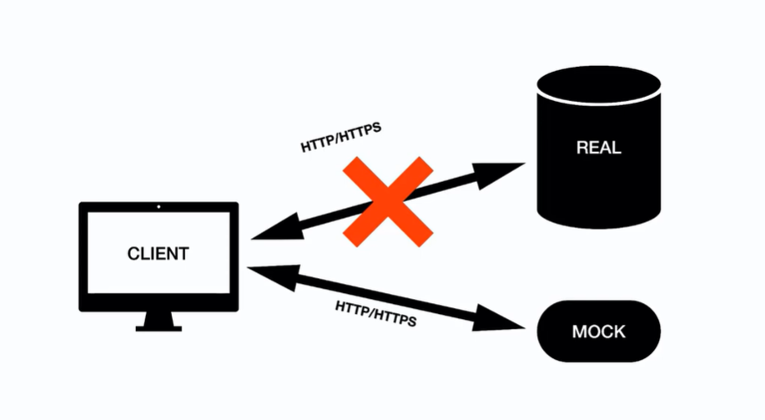

Slide 7
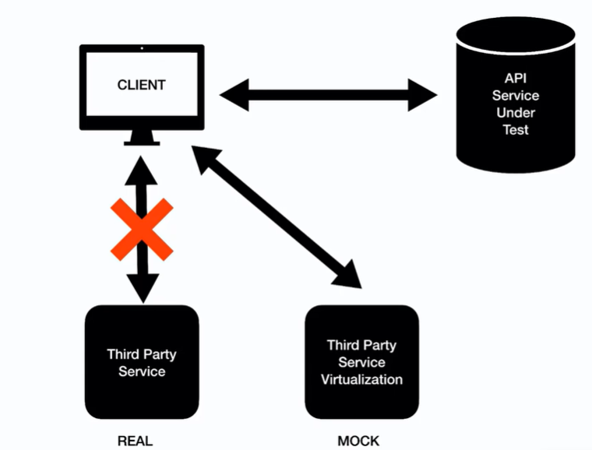

Slide 8
Techniques for Mocking in API Testing
Static Mocks: These are the simplest form, providing predefined, unchanging responses for specific API requests.
Dynamic Mocks: Allow responses to vary based on request parameters, offering more flexibility and realism testing.
Traffic-Driven Mocks: Capture and replay real traffic patterns, creating mocks that closely resemble actual API behaviour.

Slide 9
Implementing Mocks in Testing Frameworks
Different tools and frameworks support mocking in varying capacities. For instance:
Postman Mock Server: Postman allows the generation of a mock server that can return predefined responses based on the setup.
Jest and Nock in JavaScript: Jest can be used in conjunction with Nock to intercept HTTP requests and return mock responses for Node.js applications.
WireMock for Java: This is a standalone mocking server that can be used to mock HTTP-based APIs for Java applications.

Slide 10
What is WireMock?

Slide 11
What is WireMock?
WireMock is a versatile simulation tool for HTTP-based APIs which allows testing interaction with web services without having to rely on the actual live endpoints.
Primarily used in the field of software development and testing, WireMock provides functionalities to stub HTTP requests and simulate API responses.
This tool is particularly useful for developing and testing applications when the actual services are either unstable or unavailable.

Slide 12
Stubbing vs Mocking

Slide 13
Stubbing vs Mocking
Stubbing provides predefined responses to method calls, focusing on controlling the input and output of a dependency.
On the other hand, Mocking not only provide predefined responses but also verify interactions, ensuring that the code under test interacts with its dependencies as expected.

Slide 14
Steps to create stub
Download the standalone JAR from here: https://wiremock.org/docs/download-and-installation/
Run java -jar wiremock-standalone-x.x.x.jar to start the WireMock server (The default port is 8080)
Hit http://localhost:8080/__admin URL in the postman, which 200 – OK code with “{ “mappings”: [], “meta”: { “total”: 0 }}“
To change the default port number, we need to run this command --> java -jar wiremock-standalone-x.x.x.jar --port <port_number>
To up the https port we need to run this command --> java -jar wiremock-standalone-x.x.x.jar --port <port_number> --https-port <port_number>

Slide 15
Q&A

Slide 16
Thank You!

